Slide 1
Network Reference Models and Standards
Topic 7

Slide 2
Learning Outcomes
By the end of this lesson, you should be able to:
Describe the OSI and IEEE 802 networking models
Summarize the IEEE 802 networking standards

Slide 3
Introducing the OSI and IEEE 802 Networking Models
The Open Systems Interconnection (OSI) reference model proposed by the International Organization for Standardization (ISO) provides a common framework for developers and students of networking to work with and learn from
The OSI model is not specific to any protocol suite and can be applied to most networking protocols
This model is a seven-layer organization of how data travels from place to place on any given network

Slide 4
Role of a Reference Model
To see the value of a layered model outside the field of networking, look at an example of a letter being created, sent and delivered by Sing Post
The letter has to be written
The letter has to be placed in an envelope and addressed in the correct format
The envelope has to be stamped
The local post office in the destination has to sort the letter correctly based on the postal code and get it on the right plan to the destination
The post office in the destination has to sort the letter correctly to the house address
The local carrier has to deliver the letter to the correct house
The recipient has to receive the letter, open it, and read it
A layered approach to a complicated process reduces its complexity and turns it into a series of interconnected tasks

Slide 5
Role of a Reference Model
Each task of the previous example can be handled separately without affecting the procedures of the other tasks.
For example, in the step where the local carrier delivers the letter to the correct house:
Let’s say he currently walks on his route, which takes a considerable amount of time
He gets an “upgrade” to a delivery truck so that he can perform his task faster
As you can see, one part of the process can change but the rest of the process remains unchanged

Slide 6
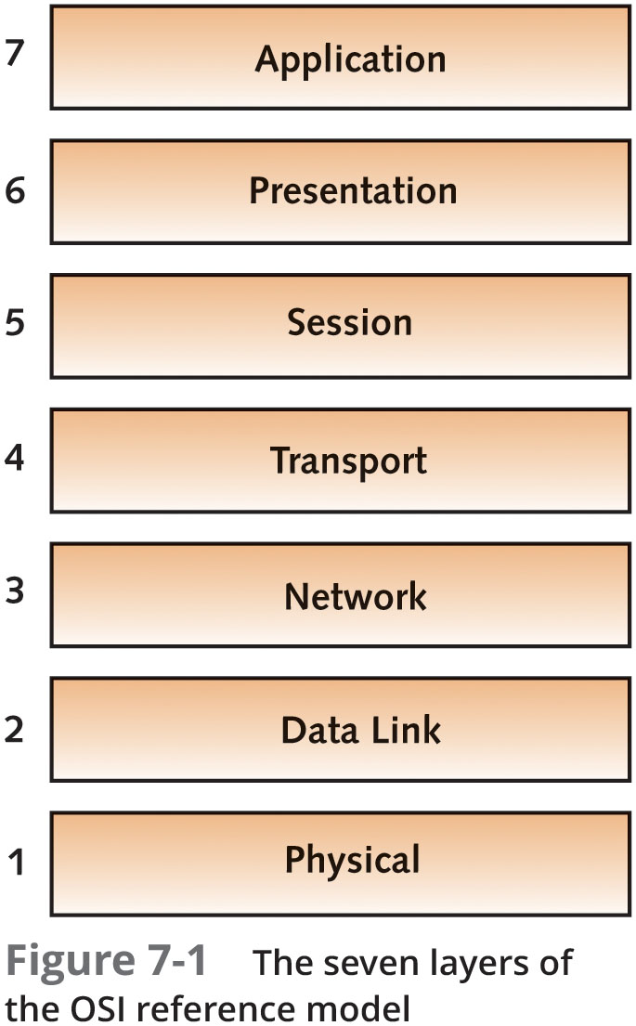
Structure of the OSI Model

Slide 7
Structure of the OSI Model
To comprehend how a network works as a whole, you need to understand:
How each layer functions
What networking components and devices operate at each layer
How layers interact with one another
Each layer in the OSI model has its own set of well-defined functions
The functions of each layer communicate and interact with the layers immediately above and below it
Example: The Transport layer works with the Network layer below it and the Session layer above it

Slide 8
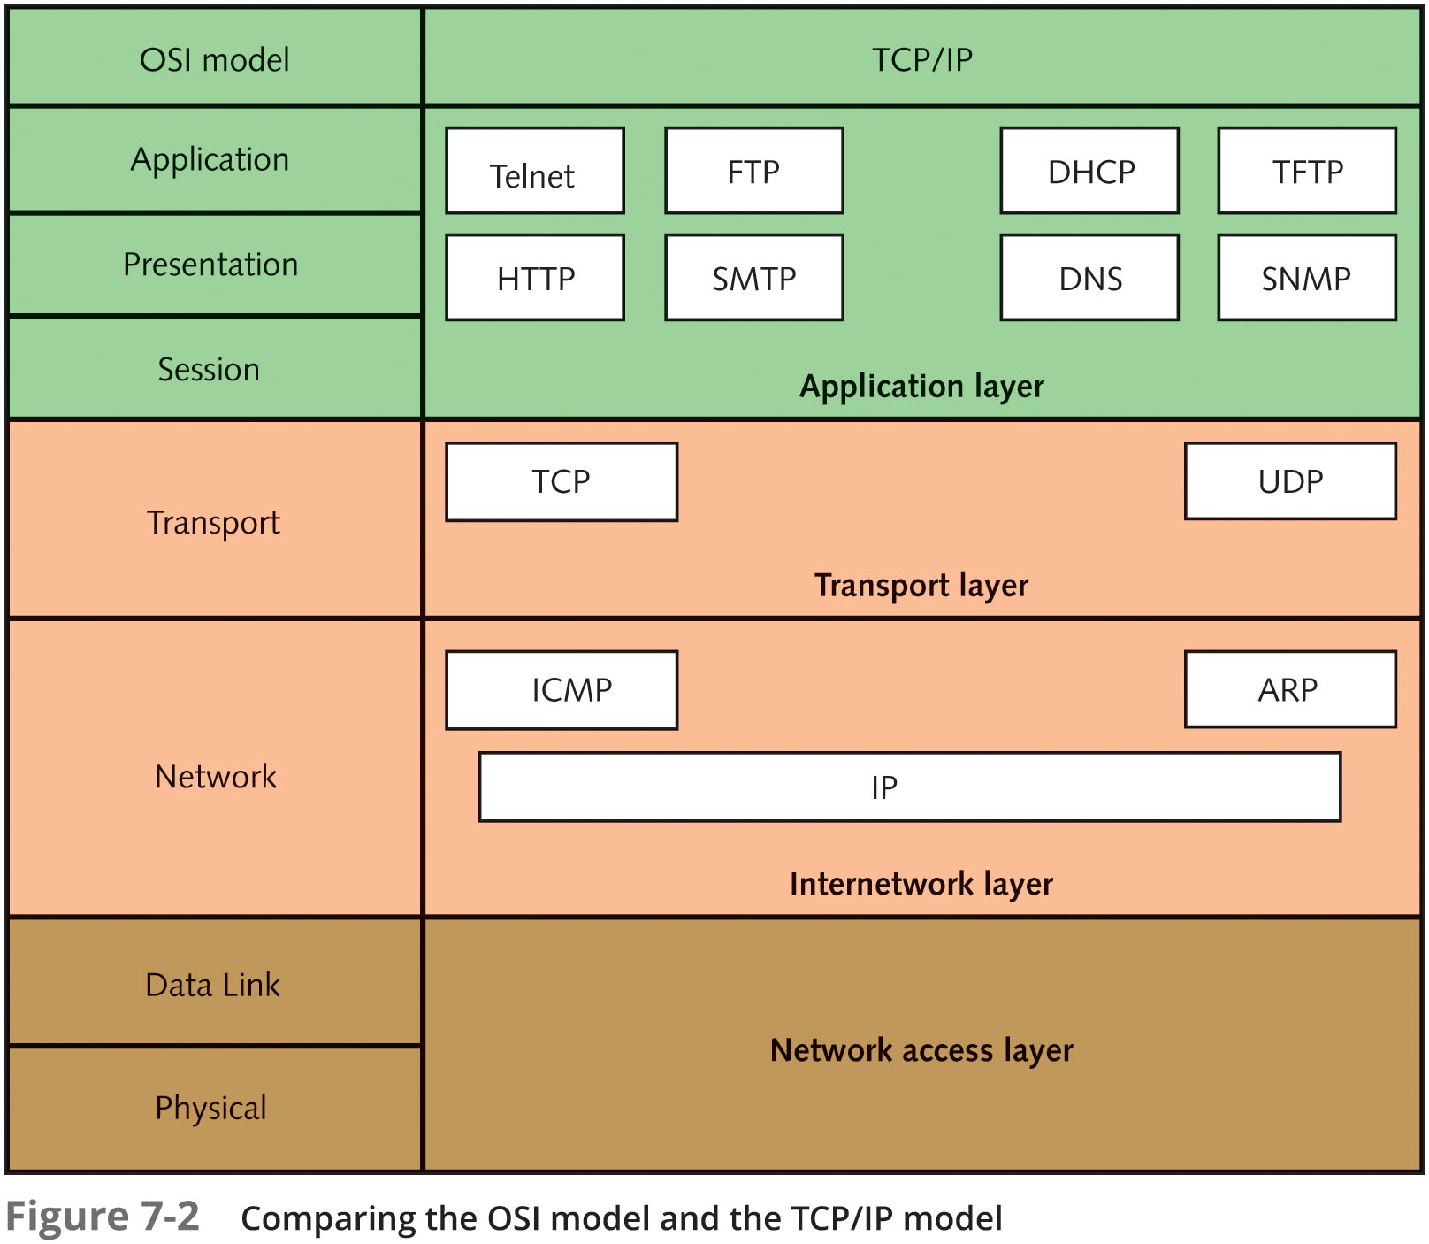
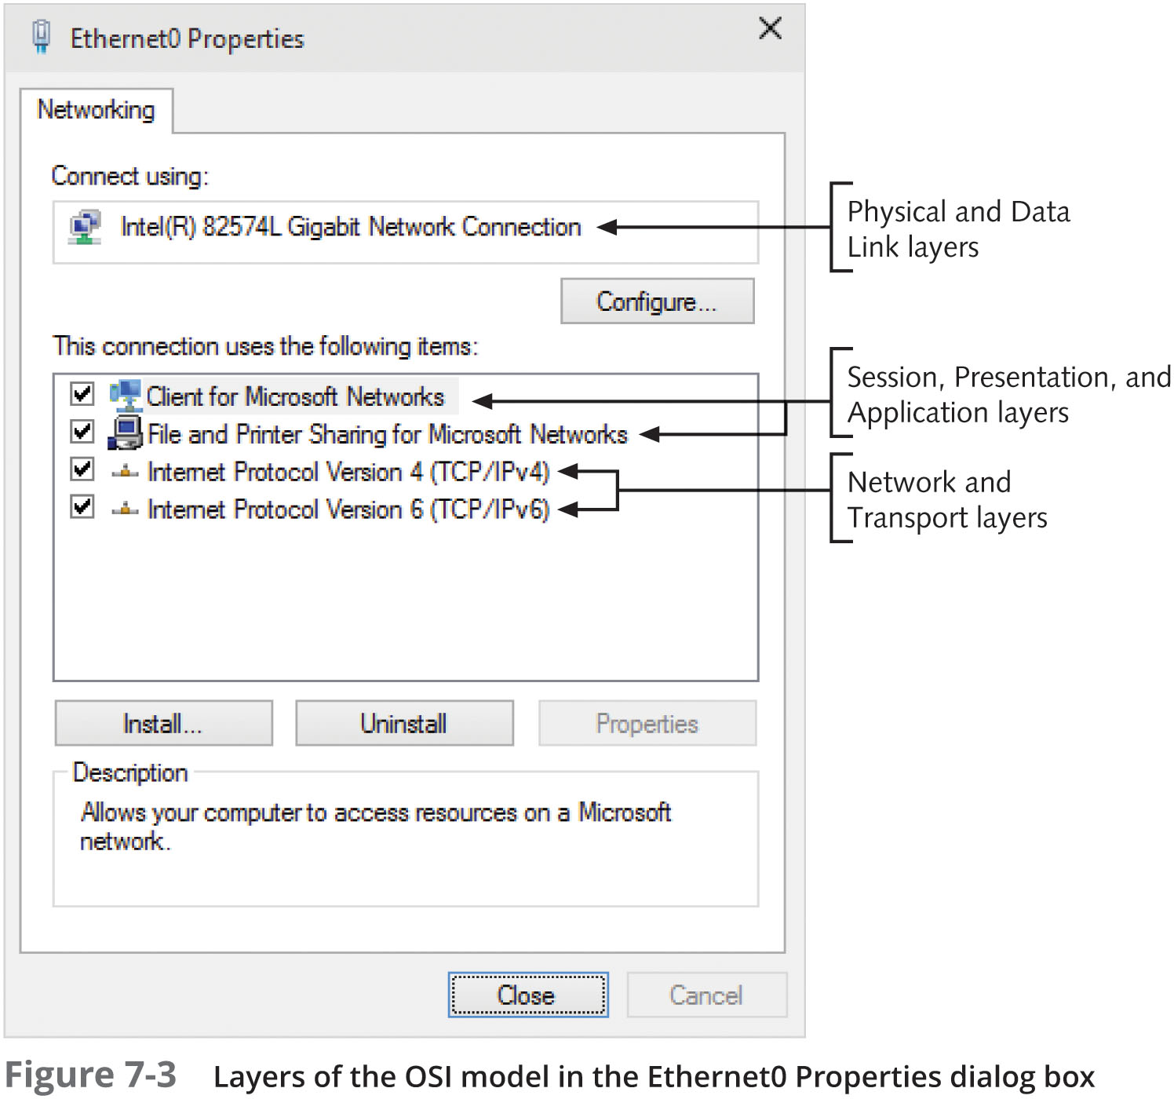
Structure of the OSI Model

Slide 9
Structure of the OSI Model
Each layer provides services to the next higher layer until the data reaches the Application layer
The Application layer has the job of providing services to user applications
Each layer on one computer behaves as though it were communicating with the same layer on the other computer
This behavior is known as peer communication between layers

Slide 10
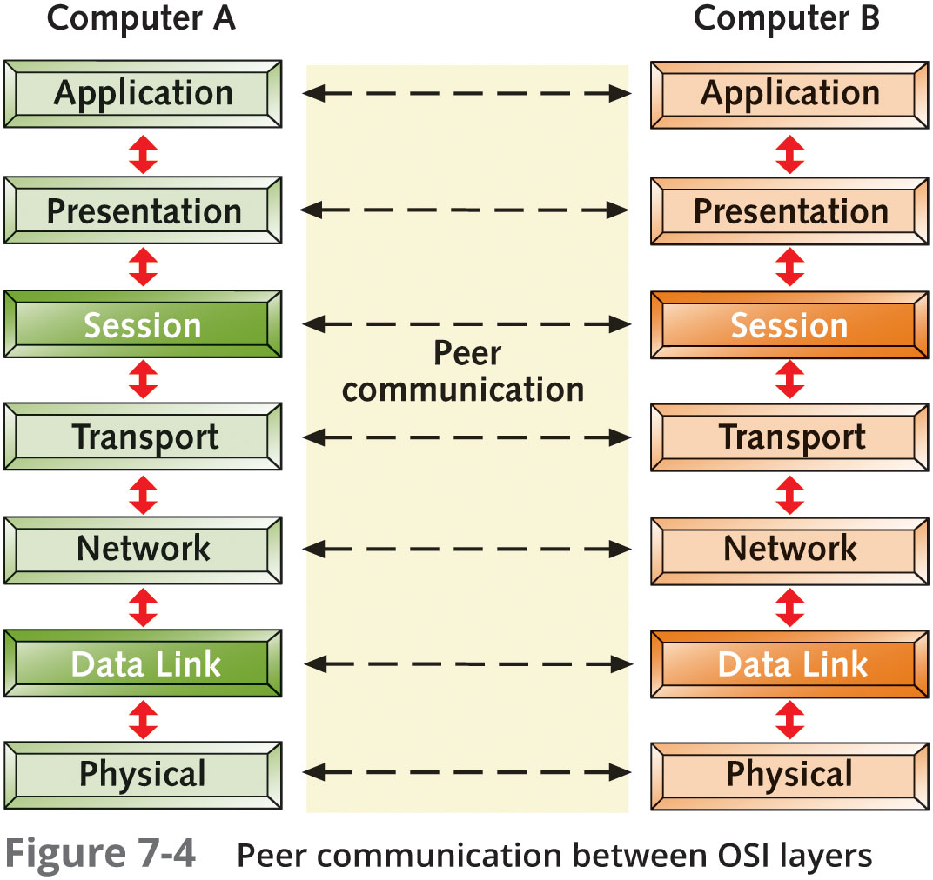
Structure of the OSI Model
Notes:
P - Please
D - Do
N - Not
T - Throw
S - Sausage
P - Pizza
A - Away

Slide 11
Structure of the OSI Model
On data’s way down the protocol stack (model):
It’s data is divided into data units suitable for each layer
Each unit, called protocol data units (PDU), is passed from one layer to another on its way up or down the protocol stack
Some layers add their own formatting to the PDU, which is called a header (encapsulation)
When data arrives at the receiving end, it is passed up the protocol stack:
At each layer, software reads its PDU data and strips its header information (called deencapsulation) and passes the PDU to the next higher layer
The packet leaves the Application layer in a format the receiving application can read

Slide 12
Application Layer
The Application layer (Layer 7) provides interfaces for applications to access network services
Examples are file sharing, message handling, and database access
Generally, components at the Application layer have both a client component and a server component
Common protocols found at Layer 7 include HTTP, FTP, SMB/CIFS, TFTP, and SMTP
Possible problems at this layer include missing or misconfigured client or server software and incompatible or obsolete commands used to communicate between a client and server

Slide 13
Presentation Layer
The Presentation layer (Layer 6) handles data formatting and translation
For outgoing messages:
It converts data into a format specified by the Application layer
For incoming messages:
It reverses the conversion if required by the receiving application
A software component known as a “redirector” operates at this layer
It intercepts requests for service from the computer, requests that can’t be handles locally are redirected across the network to a network resource that can handle the request

Slide 14
Session Layer
The Session layer (Layer 5) permits two computers to hold ongoing communications, called a “session”, so applications on either end of the session can exchange data for as long as the session lasts
This layer handles communication setup ahead of data transfers and session teardown when the session ends
Common network functions at this layer:
Name lookup and user logon and logoff
The Session layer also manages the mechanics of ongoing conversations such as identifying which side can transmit data when and for how long
Checkpointing is performed at this layer, which is a synchronization process between two related streams of data
Example: keeping the audio in sync with video

Slide 15
Transport Layer
The Transport layer (Layer 4) manages data transfer from one application to another across a network
It breaks long data streams down into smaller chunks called “segments”
Segmenting data is important because every network technology has a maximum frame size called the maximum transmission unit (MTU)
The Transport layer includes flow control and acknowledgements to ensure reliability
This layer also handles resequencing segments into the original data on receipt
The PDU at this layer is a segment
UDP’s PDU is often called a “datagram” rather than a segment

Slide 16
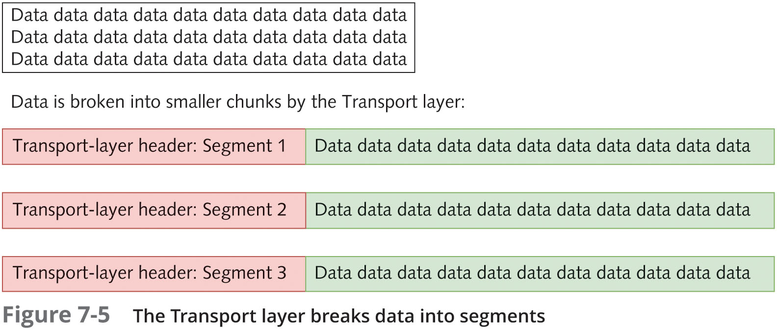
Transport Layer

Slide 17
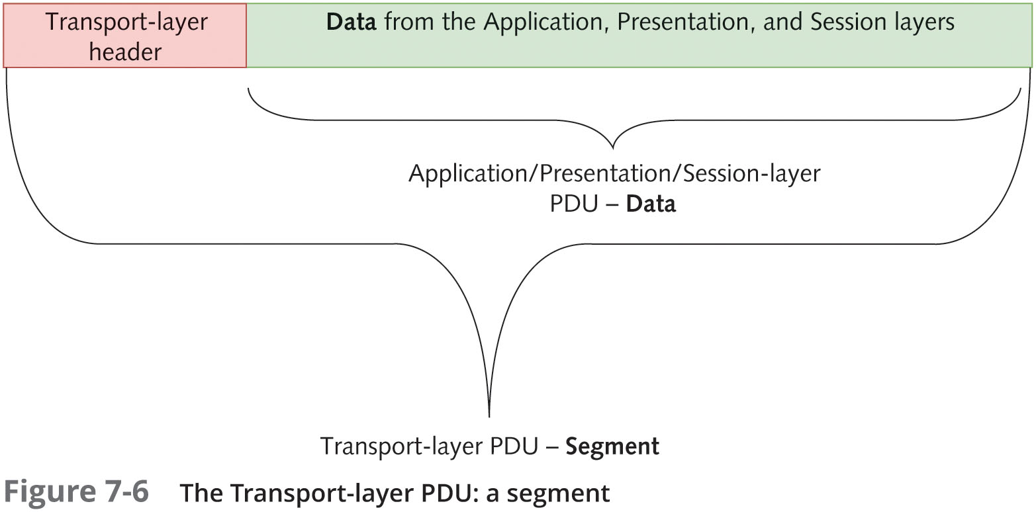
Transport Layer

Slide 18
Transport Layer
Some key fields in the Transport-layer header include:
Source and destination port numbers
Sequence and acknowledgement numbers
Window size
Problems that can occur at this layer include segments that are too large for the medium between source and destination networks
This situation forces the Network layer to fragment the segments, which causes performance degradation

Slide 19
Network Layer
The Network layer (Layer 3) handles logical addressing, translates logical network addresses (IP addresses) into physical addresses, and performs best path selection and routing in an internetwork
Access control is handled at this layer during the routing process
The router consults a list of rules before forwarding an incoming packet to determine whether a packet meeting certain criteria should be permitted through
Software components working at this layer include IP, ARP and ICMP
Routers operate at this layer
A switch with routing capabilities (called a “Layer 3 switch”), also works at the Network layer
Problems that can occur at the Network layer often include:
Incorrect IP addresses or subnet masks, incorrect router configuration, and router operation errors

Slide 20
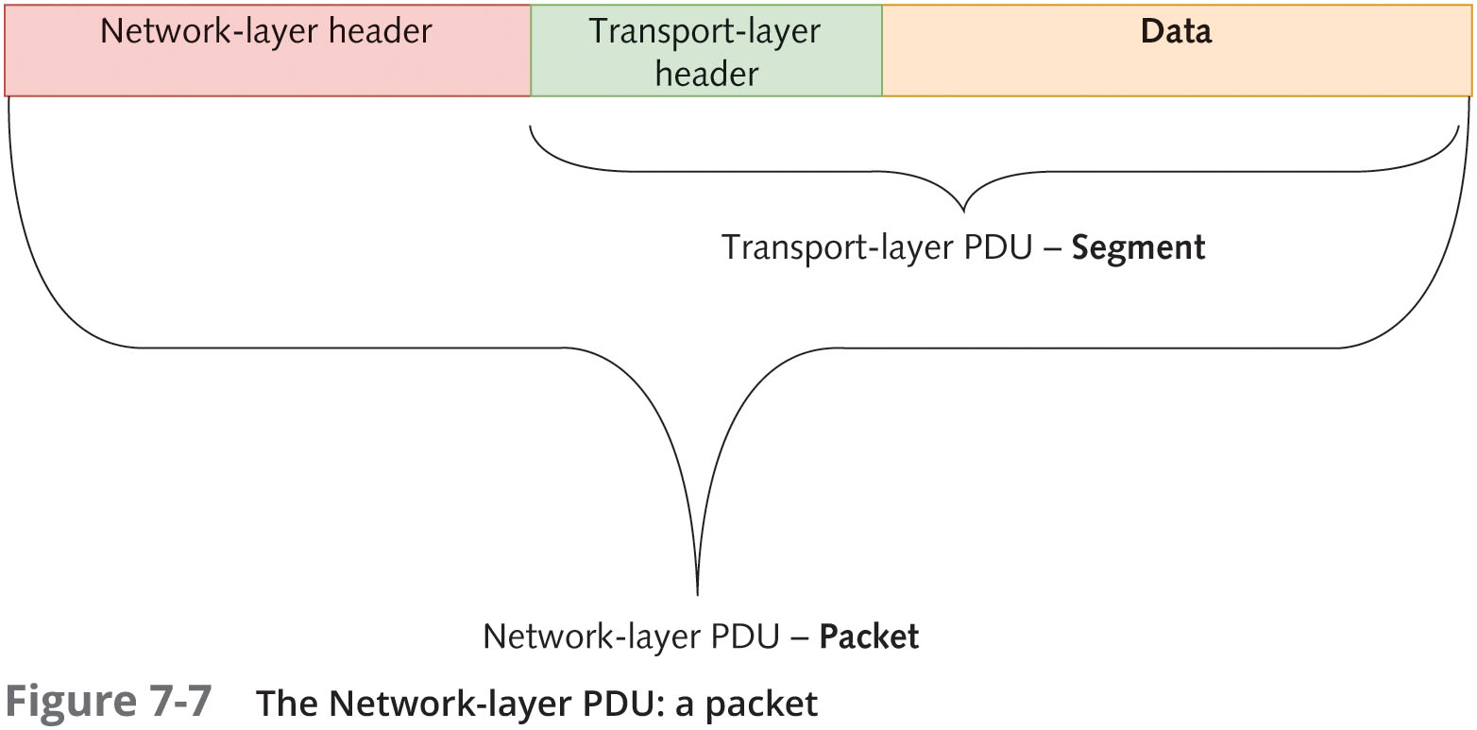
Network Layer

Slide 21
Data Link Layer
The Data Link layer (Layer 2) works with frames and is the intermediary between the Network layer and Physical layer
It defines how computers access the network medium (also called media access control)
The MAC address is defined at this layer
A layer 2 frame consists of both a header and a trailer component:
The trailer component is labeled “FCS” (frame check sequence) and contains the CRC error-checking code
The CRC value is recalculated on the receiving end
If the sent and recalculated values agree, the assumption is that the data wasn’t altered during transmission
The Data Link layer discards frames containing CRC and other frame errors

Slide 22
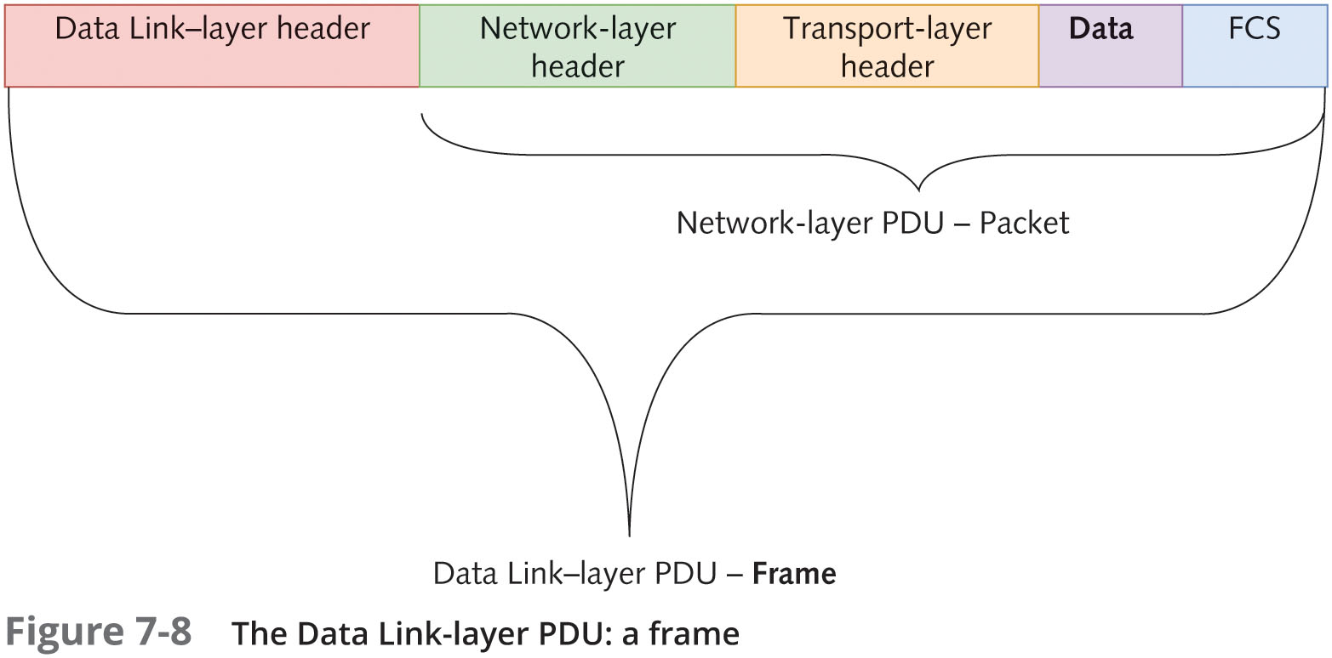
Data Link Layer

Slide 23
Data Link Layer
The Data Link header contains fields for source and destination addresses
After receiving a frame from the Physical layer and verifying the destination MAC address and the CRC, the Data Link layer strips its header and trailer information from the frame
It then sends the resulting packet up to the Network Layer for further processing
The software component operating at this layer is in the NIC driver
Hardware components that operate at this layer include NICs and switches
Problems at this layer include collisions and invalid frames, which can be caused by collisions, poor network design, line noise, or NIC driver problems
Another problem at this layer results from trying to use incompatible network technologies

Slide 24
Physical Layer
The Physical layer (Layer 1) converts bits into signals for outgoing messages and signals into bits for incoming messages
The type of signals generated depend on the medium:
Wire media uses electrical pulses, fiber-optic uses light pulses and wireless media uses radio waves
Details for creating a physical network connection are specified at this layer
Example: the type of connectors used to attach the medium to the NIC

Slide 25
Physical Layer
Encoding is representing 0s and 1s by a physical signal such as electrical voltage or a light pulse
Encoding happens at the Physical layer
Components at this layer include all the cable and connectors used on the medium, along with repeaters and hubs
Problems occurring here are often related to:
Incorrect media termination
EMI or noise that scrambles the signals
NICs and hubs that are misconfigured or malfunctioning

Slide 26
Summary of the OSI Model
The OSI model is a helpful way to categorize and compartmentalize networking activities
The OSI model helps explain how data is formatted and how it moves up and down the protocol stack and from computer to computer
The following slides summarizes the actions occurring at each layer

Slide 27
Summary of the OSI Model
Layer | PDU | Protocols/software | Devices | Function
7. Application | Data | HTTP, FTP, SMTP, DHCP | Computers | Provides programs with access to network services
6. Presentation | Data | Redirectors | N/A | Handles data representation to application and data conversions, ensures that data can be read by the receiving system, and handles encryption and decryption
5. Session | Data | DNS, authentication, protocols | N/A | Establishes, maintains, and coordinates communication between applications
4. Transport | Segment | TCP, UDP | N/A | Ensures reliable delivery of data, breaks data into segments, handles sequencing and acknowledgements, and provides flow control
3. Network | Packet | IP, ICMP, ARP | Routers, firewalls, Layer 3 switches | Handles packet routing, logical addressing, and access control through packet inspection
2. Data Link | Frame | Ethernet, token ring, FDDI, NIC drivers | Switches, NIC | Provides physical device addressing, device-to-device delivery of frames, media access control, and MAC addresses
1. Physical | Bits | N/A | Network media, hubs/repeaters, connectors | Manages hardware connections, handles sending and receiving of binary signals, and handles encoding of bits

Slide 28
IEEE 802 Networking Standards
The Institute of Electrical and Electronics Engineers (IEEE) defined LAN standards to ensure that network interfaces and cabling from multiple manufacturers would be compatible
This effort was called Project 802 to indicate the year (1980) and the month (Feb) of its inception
IEEE 802 predates the OSI Model
Most of the standards affect the elements from the lower two levels of the OSI Model
The 802 specifications describes how NICs can access and transfer data across a variety of networking media and what’s involved in attaching, managing, and detaching these devices in a network

Slide 29
IEEE 802 Specifications
The IEEE numbers the collections of 802 documents starting with 802.1, 802.2, etc…
When a technology is enhanced each enhancement is specified by letters after the number
For example: 802.3 is the original Ethernet and 802.3u specifies 100BaseT Ethernet
The following slides lists the major 802 categories;
The 802.3 and 802.11 are the most widely used technologies of Ethernet and Wi-Fi, as of this point

Slide 30
IEEE 802 Specifications
Standard | Name | Explanation
802.1 | Internetworking | Covers routing, bridging, and internetwork communication
802.2 | Logical Link Control | Covers error control and flow control over data frames (inactive)
802.3 | Ethernet LAN | Covers all forms of Ethernet media and interfaces, from 10 Mbps to 10 Gbps (10 Gigabit Ethernet)
802.4 | Token Bus LAN | Covers all forms of token bus media and interfaces (disbanded)
802.5 | Token Ring LAN | Covers all forms of token ring media and interfaces
802.6 | Metropolitan Area Network | Covers MAN technologies, addressing, and services (disbanded)
802.7 | Broadband Technical Advisory Group | Covers broadband networking media, interfaces, and other equipment (disbanded)
802.8 | Fiber-Optic Technical Advisory Group | Covers use of fiber-optic media and technologies for various network types (disbanded)

Slide 31
IEEE 802 Specifications
Standard | Name | Explanation
802.9 | Integrated Voice/Data Networks | Covers integration of voice and data traffic over a single network medium (disbanded)
802.10 | Network Security | Covers network access controls, encryption, certification, and other security topics (disbanded)
802.11 | Wireless Networks | Sets standards for wireless networking for many different broadcast frequencies
802.12 | High-Speed Networking | Covers a variety of 100 Mbps-plus technologies, including 100VG-AnyLAN (disbanded)
802.13 | Unused
802.14 | Cable Modems | Specifies data transport over cable TV (disbanded)
802.15 | Wireless PAN | Covers standards for wireless personal area networks
802.16 | Wireless MAN (WiMAX) | Covers wireless metropolitan area networks

Slide 32
IEEE 802 Specifications
Standard | Name | Explanation
802.17 | Resilient Packet Ring | Covers emerging standards for very high-speed, ring-based LANs and MANs
802.18 | Wireless Advisory Group | A technical advisory group that monitors radio-based wireless standards
802.19 | Coexistence Advisory Group | A group that addresses issues of coexistence with current and developing standards
802.20 | Mobile Broadband Wireless | A group working to enable always-on, multivendor, mobile broadband wireless access
802.21 | Media Independent Handoff | A group working to enable handoff between wireless networks of the same or different types
802.22 | Wireless Regional Area Network | A group of working to bring broadband access to hard-to-reach low-population areas
802.23 | Emergency Services Working Group | A group working to facilitate civil authority communication systems

Slide 33
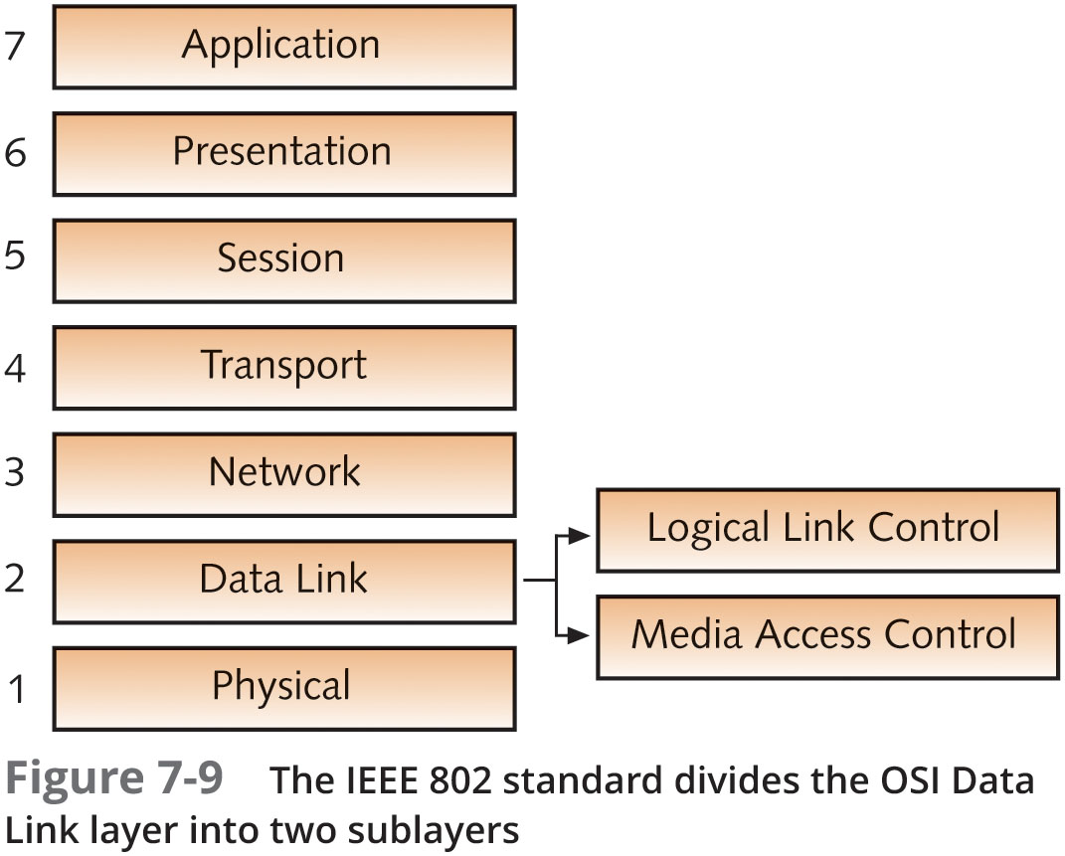
IEEE 802 Extensions to the OSI Reference Model
The IEEE 802 specification expanded the OSI model by separating the Data Link layer into these sublayers:
Logical Link Control (LLC) sublayer controls data-link communication and defines the use of logical interface points used to communicate to the upper OSI layers
Media Access Control (MAC) sublayer manages access to the physical medium and communicates with the Physical layer

Slide 34
Summary
The OSI reference model and IEEE 802 define a frame of reference for networking and specify the operation of most networking technologies in current use
The OSI reference model separates networking into seven layers, each with its own purposes and activities
Following is a summary of the functions of each OSI Model layer:
Application – Provides access to network resources
Presentation – Handles data formatting and translation
Session – Manages ongoing conversations between two computers
Transport – Breaks long data streams into smaller chunks (segments)
Network – Provides best path selection and IP addressing
Data Link – Defines how computers access the media
Physical – Converts bits into signals and defines media and connectors
The IEEE 802 project defines a set of networking standards to ensure that network interfaces and cabling from multiple manufacturers would be compatible
The IEEE 802.2 standard specifies a Logical Link Control (LLC) and Media Access Control (MAC) sublayer

